Slide 1
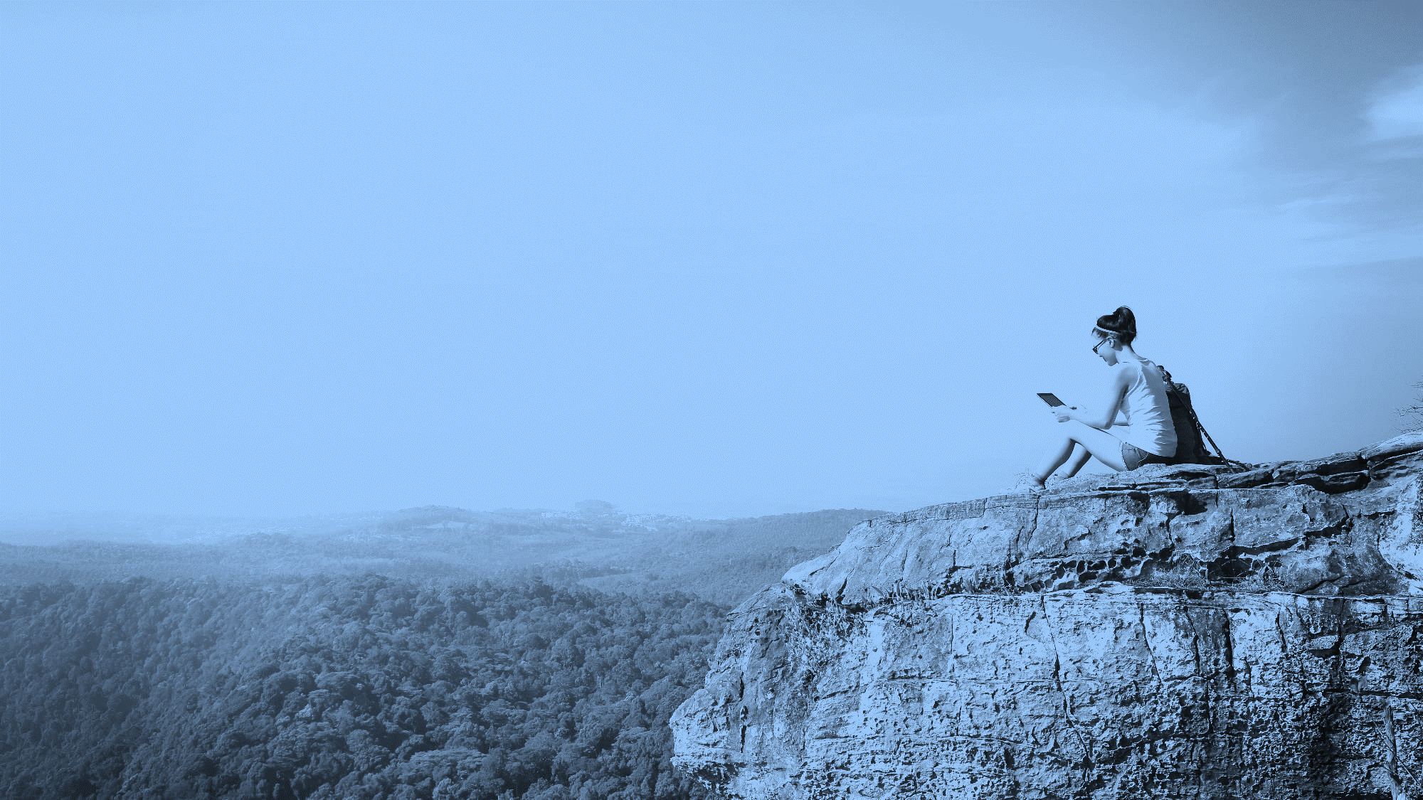
PARK SEARCH
The Great Outdoors Made Easy for Baltimore County
COSC 412
Notes:
To use this title animation slide with a new image simply 1) move the top semi-transparent shape to the side, 2) delete placeholder image, 3) click on the picture icon to add a new picture, 4) Move semi-transparent shape back to original position, 5) Update text on slide.

Slide 2
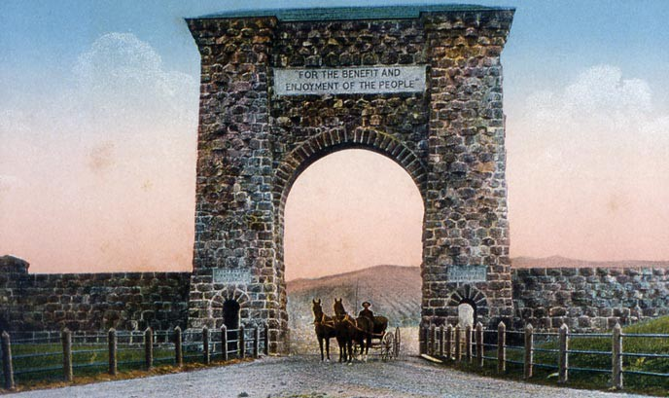
“FOR THE BENEFIT AND ENJOYMENT OF THE PEOPLE”
—The Roosevelt Arch, Yellowstone National Park

Slide 3
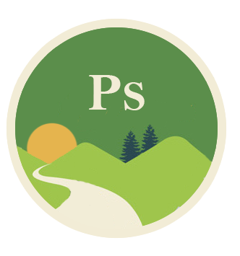
INTRODUCTION
Our mission
To help people easily access public park information in an educational and fun dynamic web app, so that they may better enjoy the wonderlands of Earth.
Park Search explained.
Why public parks?
Public, easily accessible information makes for easy database set-up
Humanitarian (net gain to society)
Baltimore is a city with low access to nature reserves and unpaved, truly natural parks.

Slide 4
DESIGN
Search functions, peppered with features that make these great spaces accessible to all.
“What parks do I not know about?”
Park Search has listings for parks that were hand-selected by the most avid outdoorsman. There might be public spaces in your very neighborhood that you never knew about.
“What does this park offer?”
Each park is different. Do you want to fish? Hike? Climb?
Do you want to picnic with your family? Do you want to play tennis?
“How will the app know what’s right for me?”
Park Search will offer a series of dynamic search tools which will allow the user to pic and choose what features they desire.

Slide 5

Encyclopedic Knowledge, Search Made Easy
FUNCTION

Slide 6
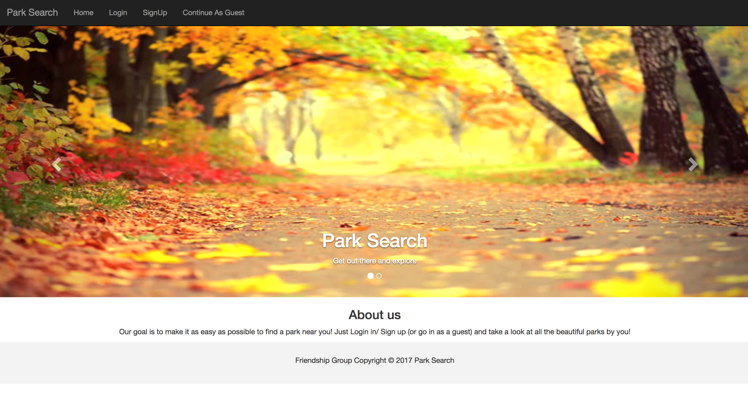
How It Works
1
2
3
4
5
User will be prompted to enter the zip-code of the area you would like to search
User will have the opportunity to “check” boxes that correspond to certain attributes
Park Search will return results that match these qualifiers
Pictures, ratings, reviews, tip & tricks will be displayed on the page for each park
User will have the opportunity to leave their own pictures, reviews, tips & tricks for each park
Reference : The basics you can find anywhere 5 Steps To Successful Storytelling Published on April 5, 2014 Featured in: Marketing & Advertising

Slide 7
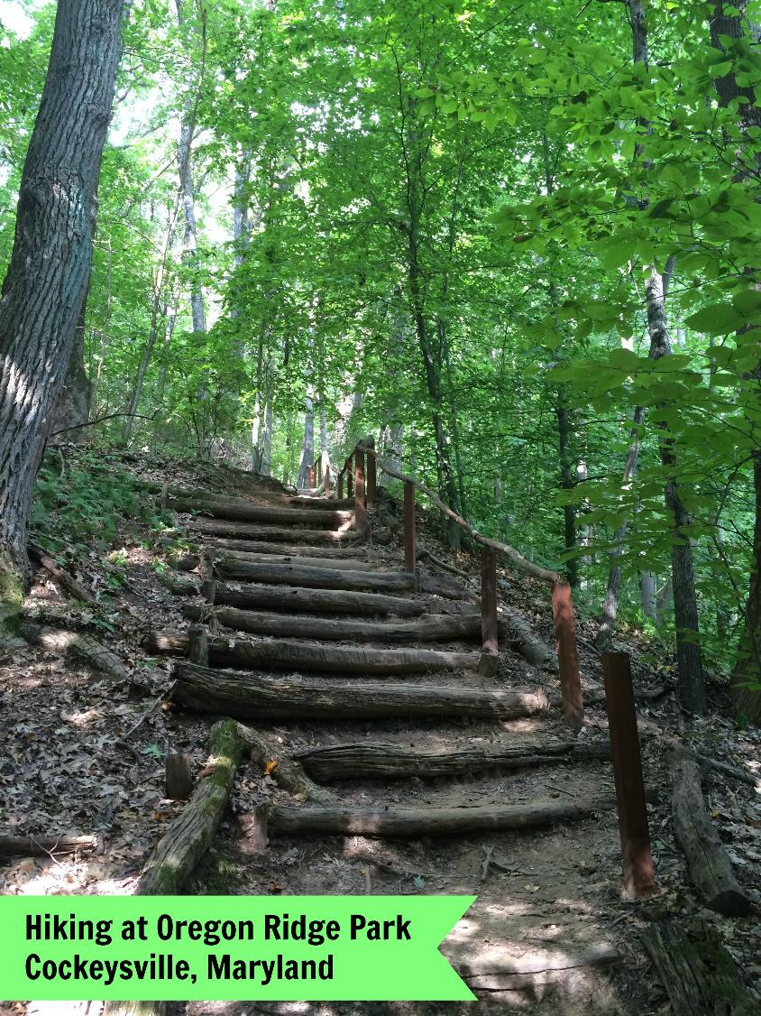
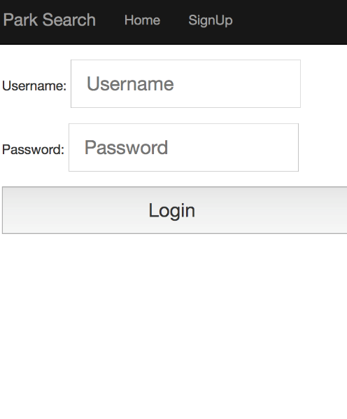
1
Logging In
You must have an account to take full advantage of our free services.
This can, however, be enjoyed without making an account. We made the account creation very non-intrusive.

Slide 8
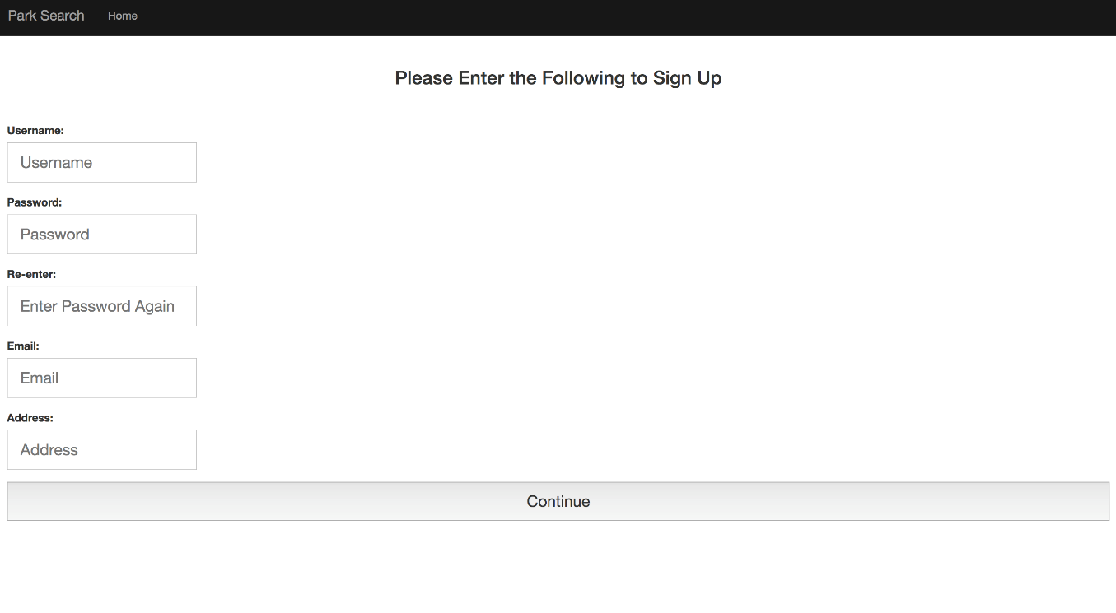
1.1
Again, non-intrusive

Slide 9
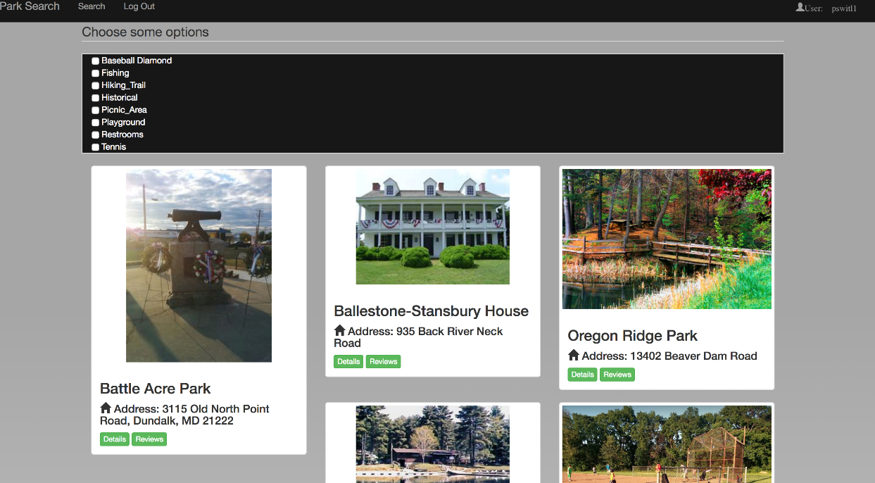
2
The Parks
Here you will find a list of the parks of Baltimore County.
Note the search boxes. We felt it was easier for the user to know what their options were before hammering in search terms. They’re not looking to define something, they’re looking to narrow their choices.

Slide 10
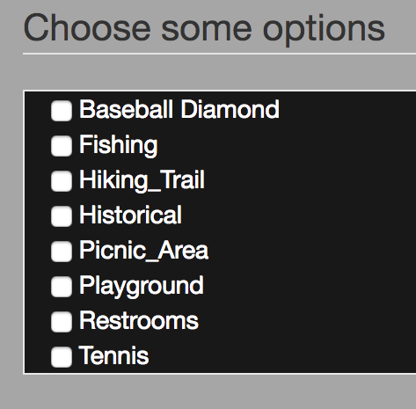
2.2
Checking Off Those Boxes
SEARCHING
Narrow the results so they show what you want. Options for bathrooms, playgrounds, hiking, fishing, historical significance, and more.

Slide 11
3
RESULTS
Park Search returns the parks that check off all the boxes. If you want a park that allows, and also hiking trails, Park Search will give you every park that features these options.
The user can easily refine their search to add and remove qualifiers to make for better results.
Notes:
Tip:
When using complex image as full-bleed background add a transparency (70%-90%) fill layer to give contrast to text.

Slide 12
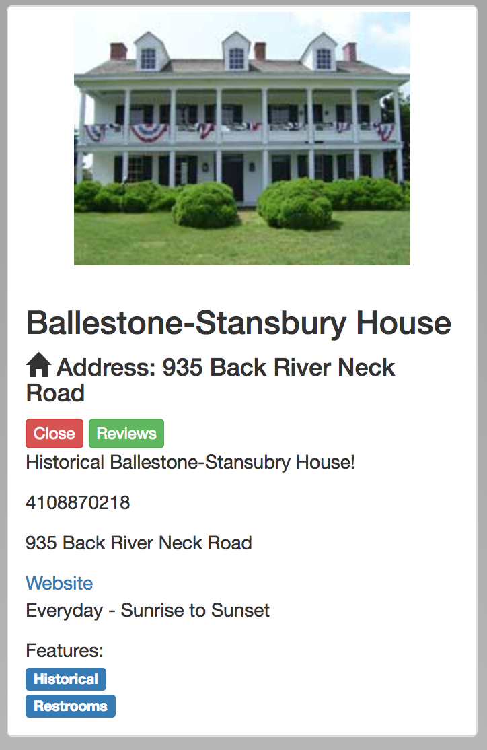
3.1
Park Search returns exactly what you need to get out there and enjoy the world.
ATTRIBUTES
Hours
Address
Pictures
Contact Information

Slide 13
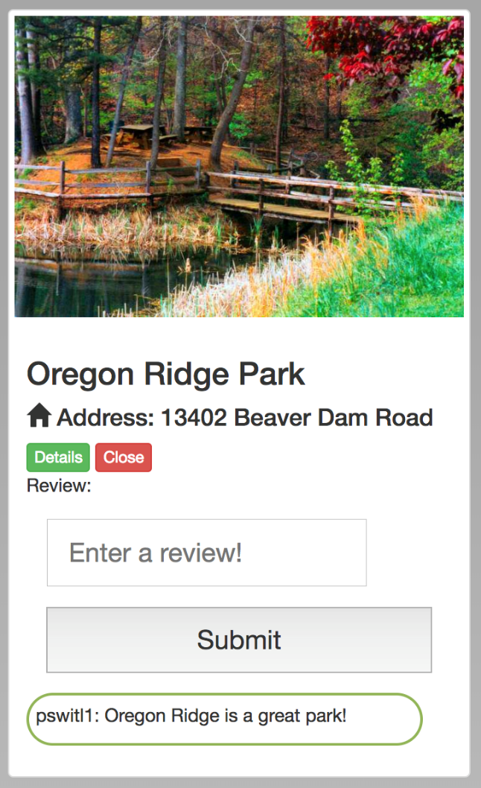
3.2
Park Profiles
Here we have the details pane closed, and the review field ready to go. Let the world know your thoughts!

Slide 14
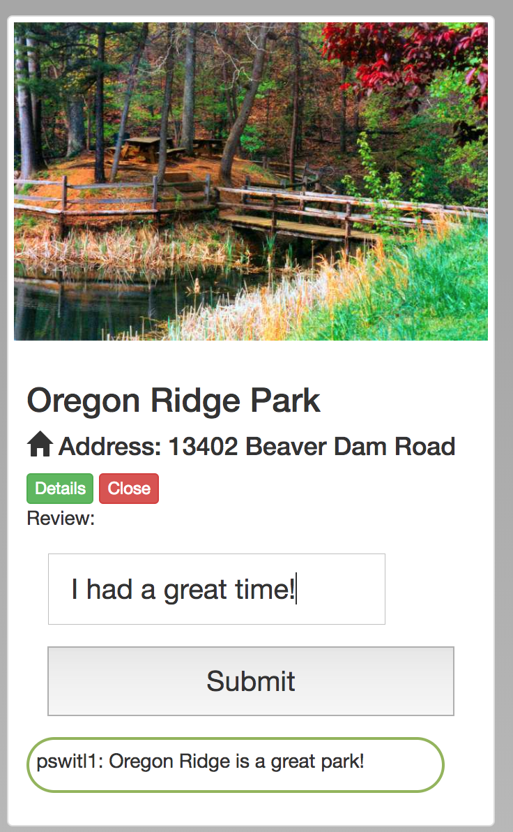
4
Let the World Know Your Thoughts
REVIEWS
Leave a review! A description of your visit, any info you learned, and any interesting tips & tricks you learned!

Slide 15
Opportunity for Growth
Park Search, Expanded
Our dynamic web app will only be written for Baltimore County parks, but can be easily expanded to include all of Maryland, and even nationally!
!
Why stop at Baltimore County? The United States has 53 national parks, and over 6,600 state parks. While our scope starts locally, in Baltimore County, it can be easily expanded to include entire states, regions, or countries!

Slide 16
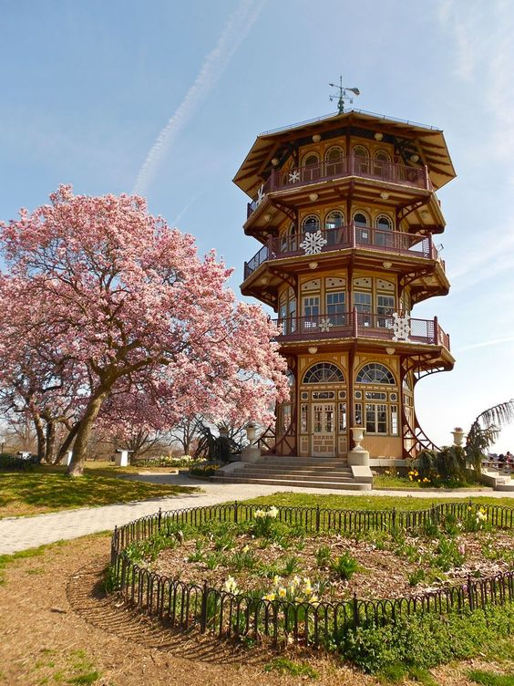
NEW FEATURES
Park Search could, in later stages, include upcoming events or festivals, concerts, holiday specials
EXPANSION
The scope starts small, with Baltimore County, but could easily grow to cover the entire state, or even entire countries.
MONETIZATION
Profit will not be the forefront of this project, just due to the noble nature of parks themselves. Advertisements or paid, premium memberships could be implemented, but it would be tricky since the target audience would reject such brazen marketing ploys. But parks might be willing to pay to directly advertise their upcoming events, and that wouldn’t be a slimy as selling ad-space for typical marketing ploys
Patterson Park, Baltimore, MD
Notes:
Combine an image and multiple key statements with a strong grid.

Slide 17
“FAR AND AWAY THE BEST PRIZE THAT LIFE HAS TO OFFER IT THE CHANCE TO
WORK HARD AT WORK WORTH DOING.”
—THEODORE ROOSEVELT

Slide 18
PARK SEARCH
THANK YOU

